Slide 1
Intro to Sequence Models and Natural Language Processing
Includes some work by undergraduate researchers: April Volzer, Noah Madrid, Hyechan Jun, Advait Scaria, Ha-Ram Koo, Joseph Jinn

Slide 2
Across-the-row exercise
Slide will give a cue, and which half-row will participate
Each person says one word on their turn
Start at the middle, go towards outside.
I’ll start us off with a trigram

Slide 3
A
Who: Front row by whiteboard
Notes:
The cue is “A”. I say “B”

Slide 4
For
Who: Middle row by windows

Slide 5
Two
Who: Back row by windows

Slide 6
In the beginning was the Word, and the Word was with God, and the Word was God. He was with God in the beginning. Through him all things were made; without him nothing was made that has been made. In him was life, and that life was the light of all mankind.
John 1 (NIV)
Notes:
Respect for the Word. Approach this topic with reverence.

Slide 7
“One-Word Story”
Go around the room
Each person says one word (keep it moving)
Tell a coherent story.
Notes:
Once upon a time

Slide 8
Logistics
Check Moodle grades
Did you forget to reply in a discussion?
Did you forget to turn in a Reflection?
Office Hours are here for you! E.g., today 2pm
Don’t forget:
Discussion 7: Wednesday
Homework 7: Thursday
Preparation 8: postponed to Wednesday
Projects: more details posted, milestone coming up!
Contributing to review materials

Slide 9
Today
Predictive text shapes our writing (my dissertation and current work)
Intro to Natural Language Processing

Slide 10
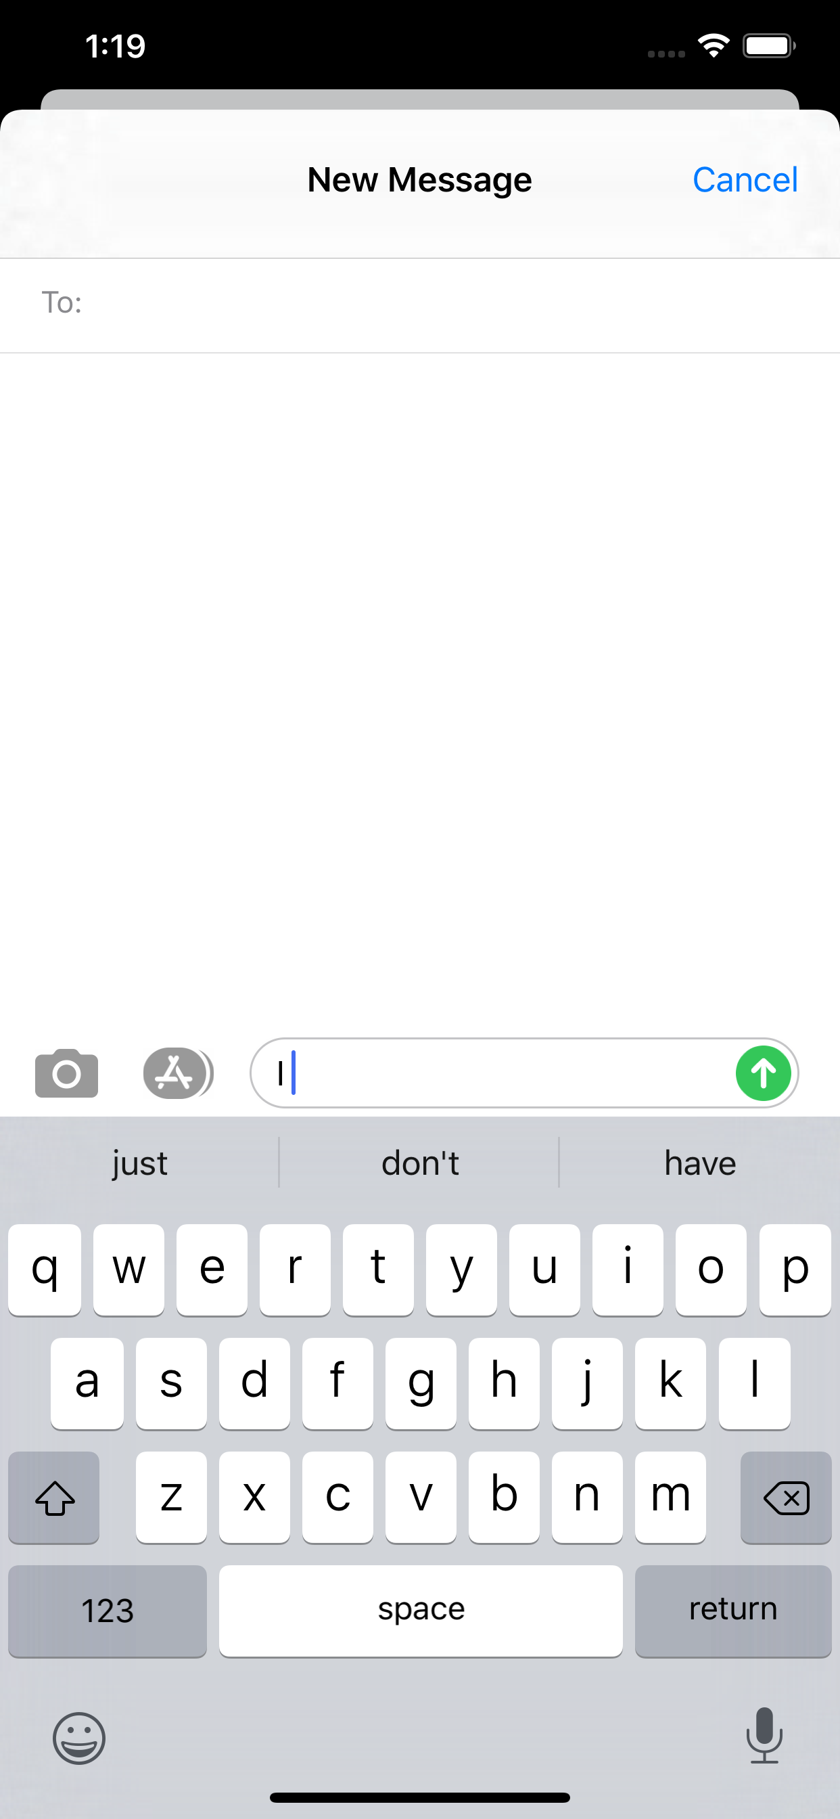
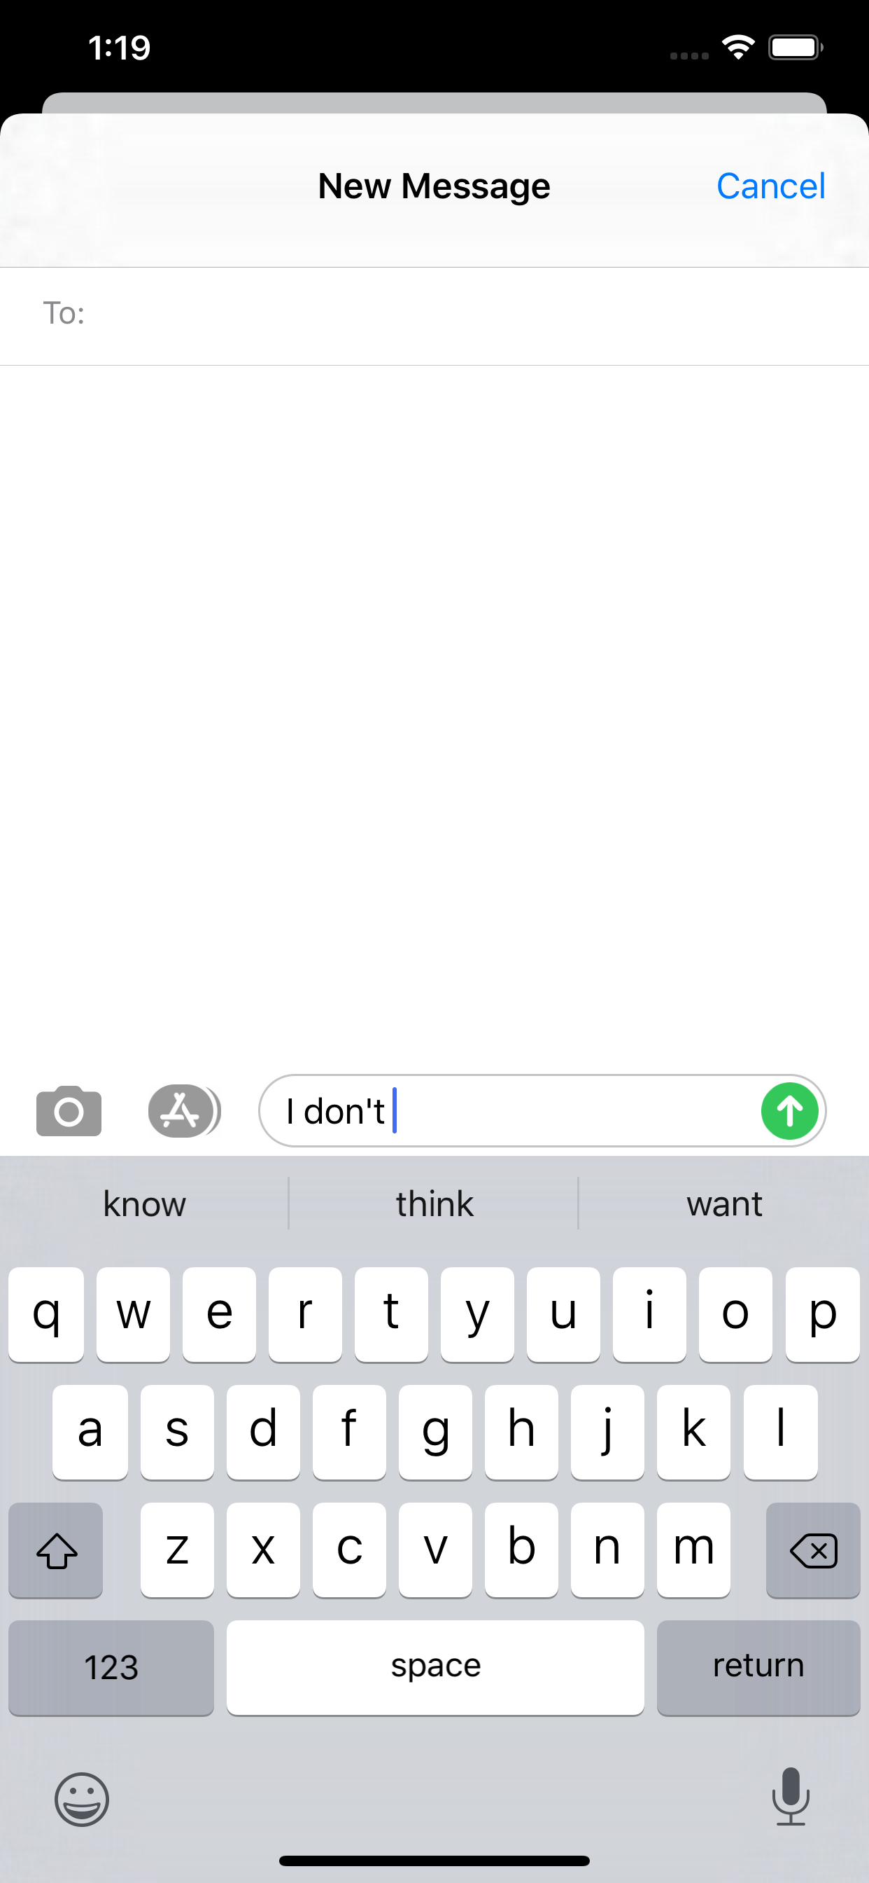
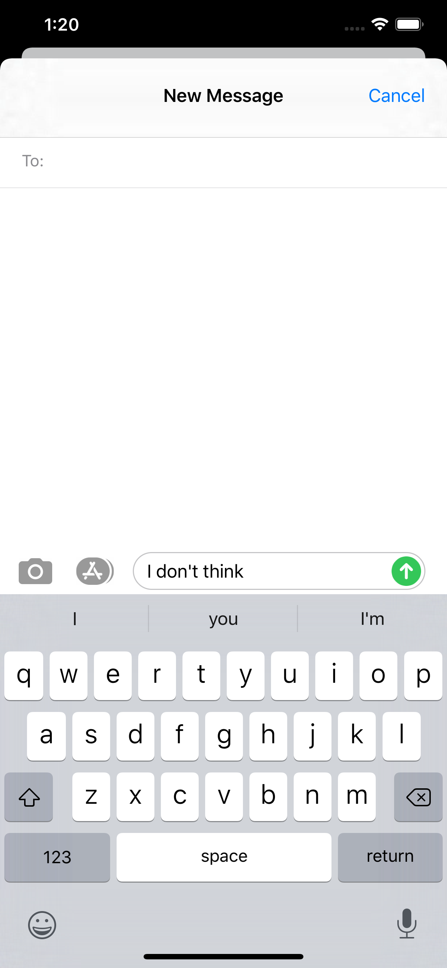
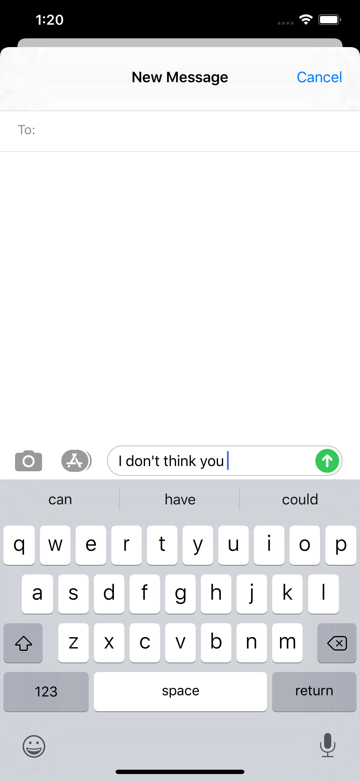
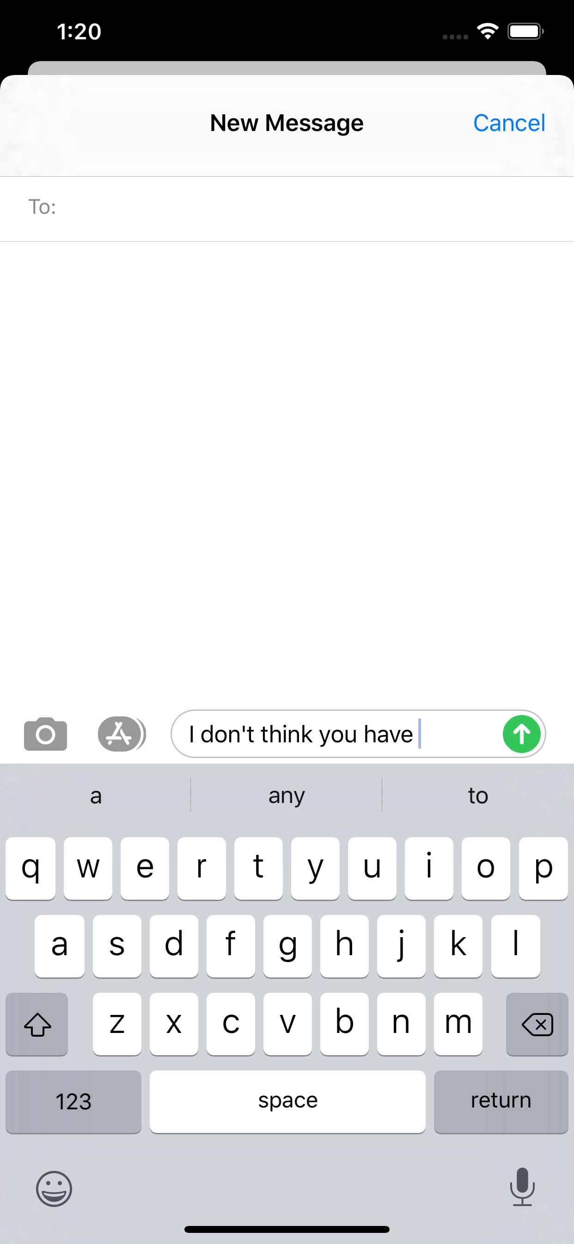
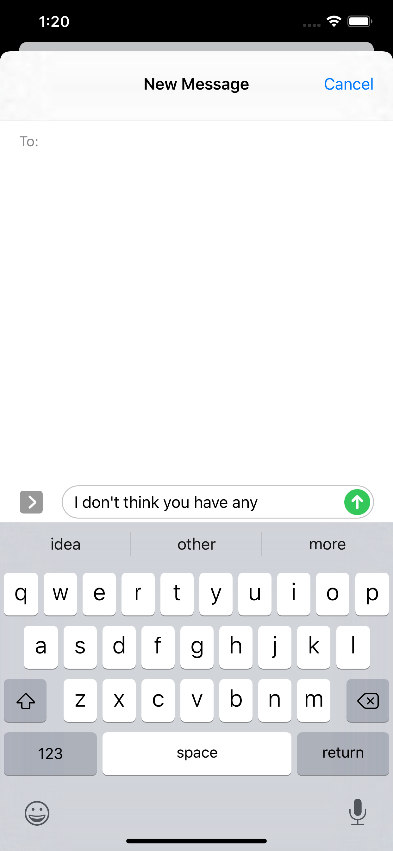
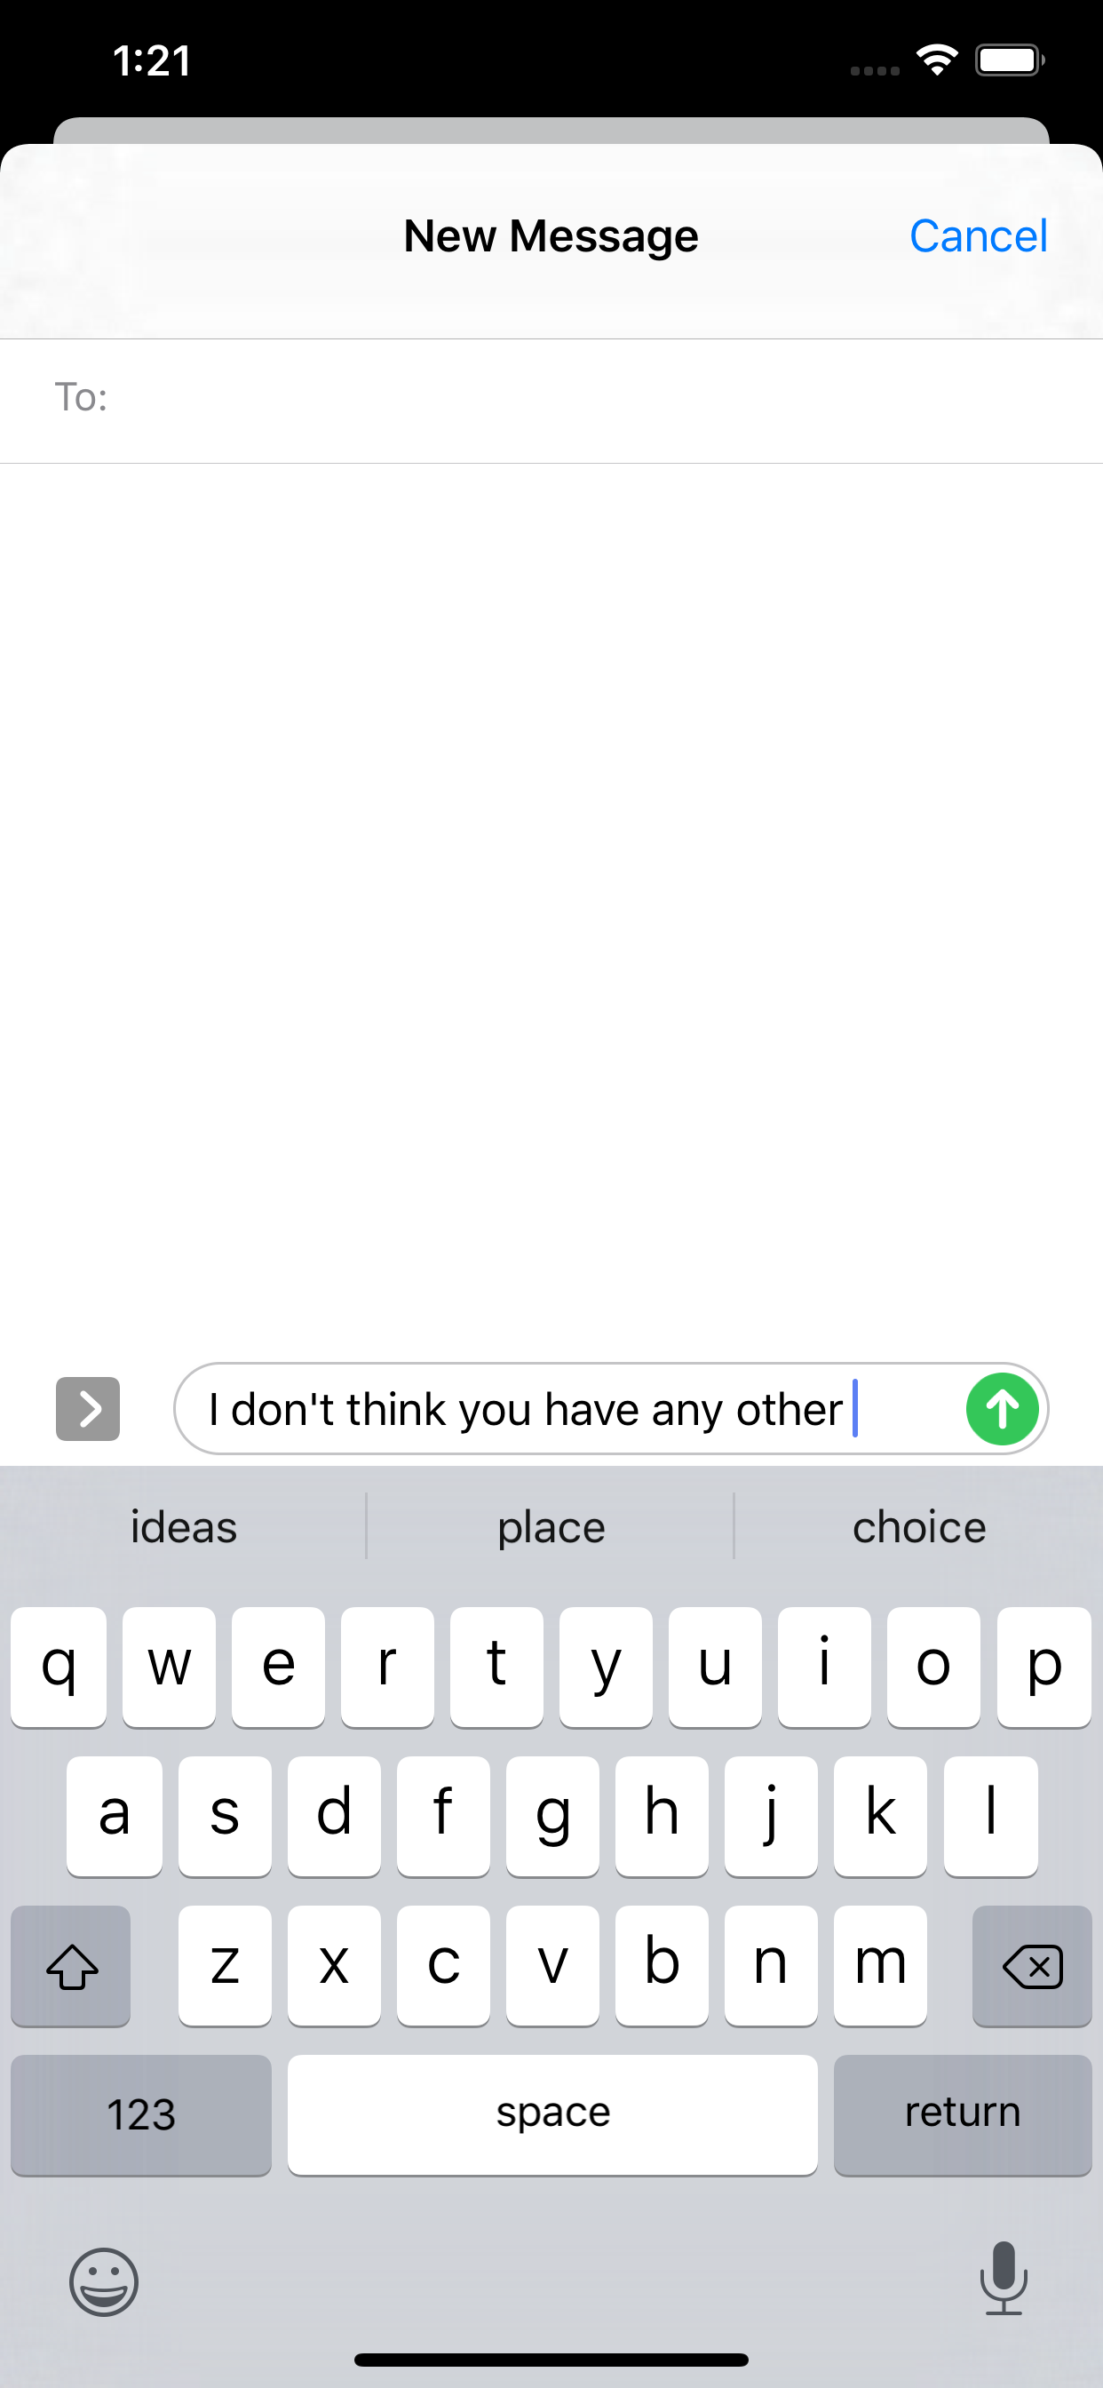
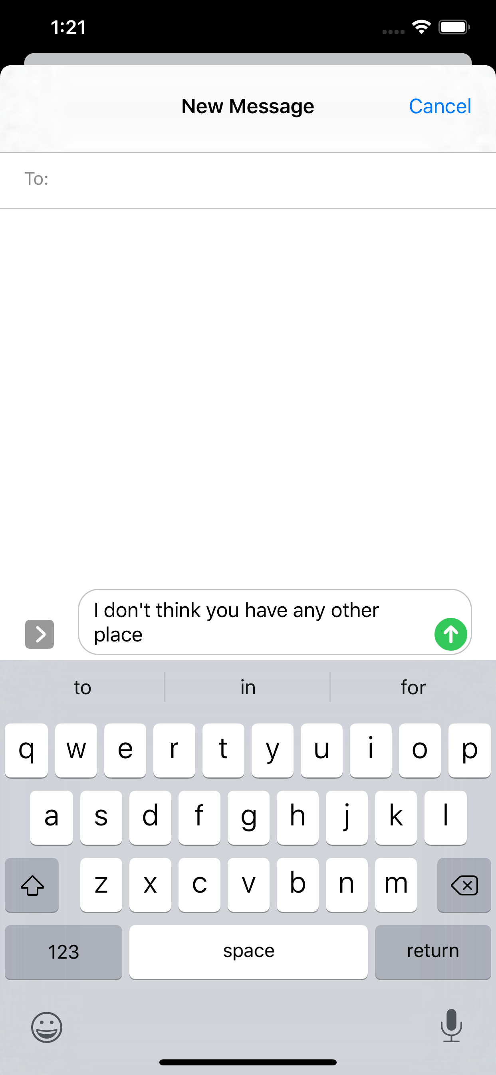

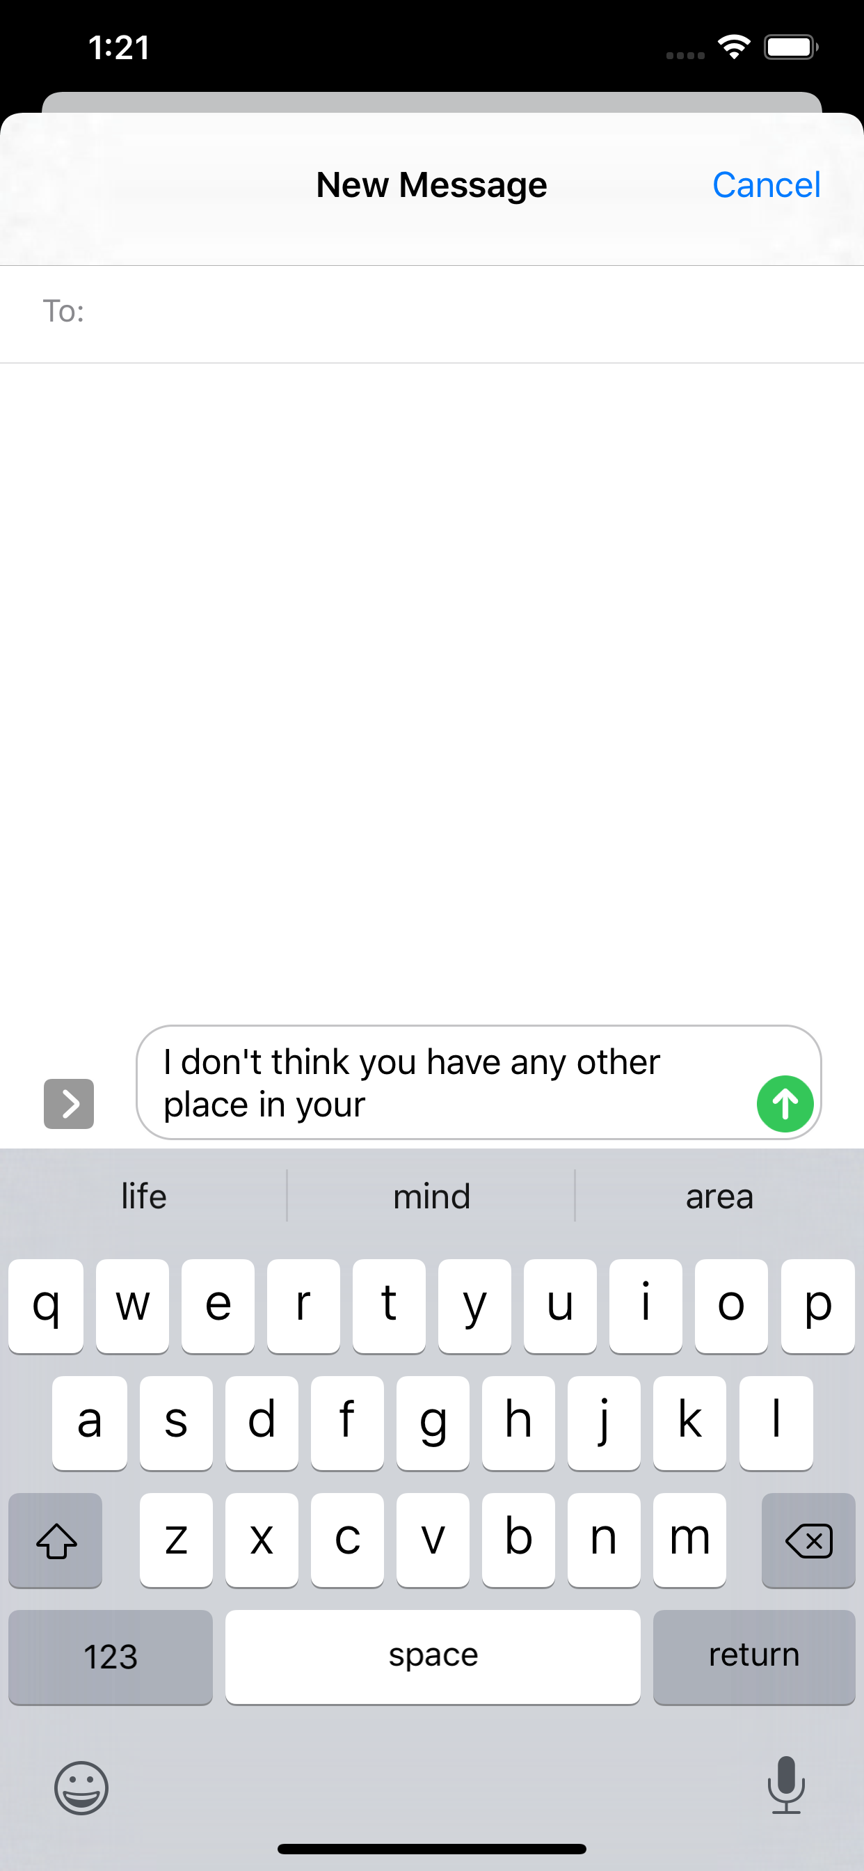
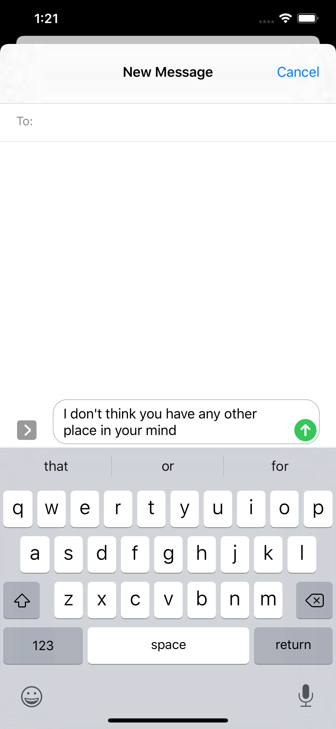
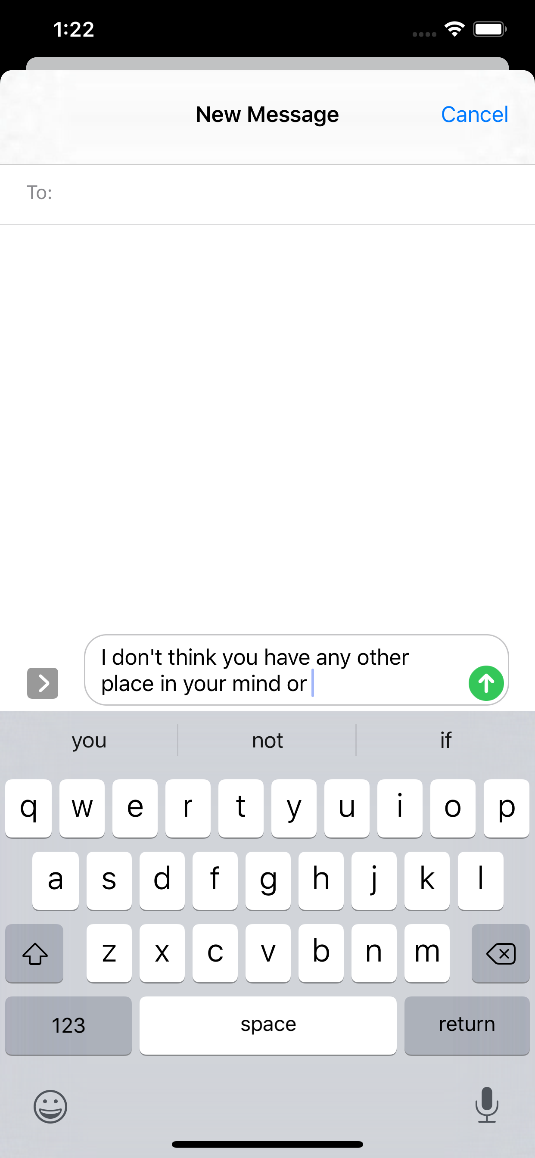

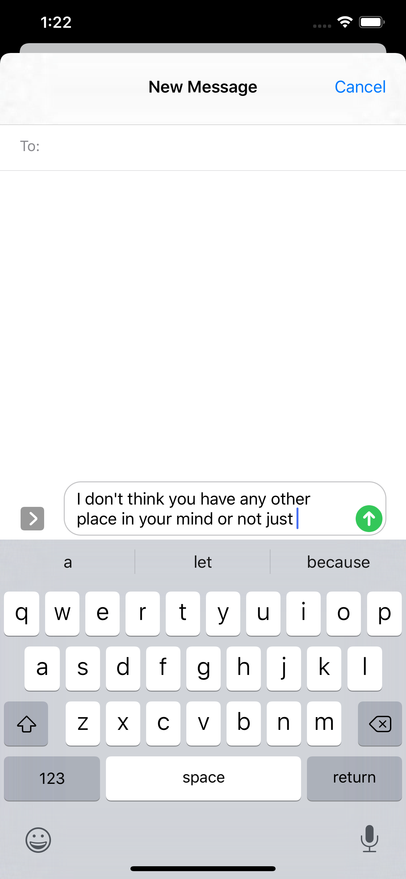
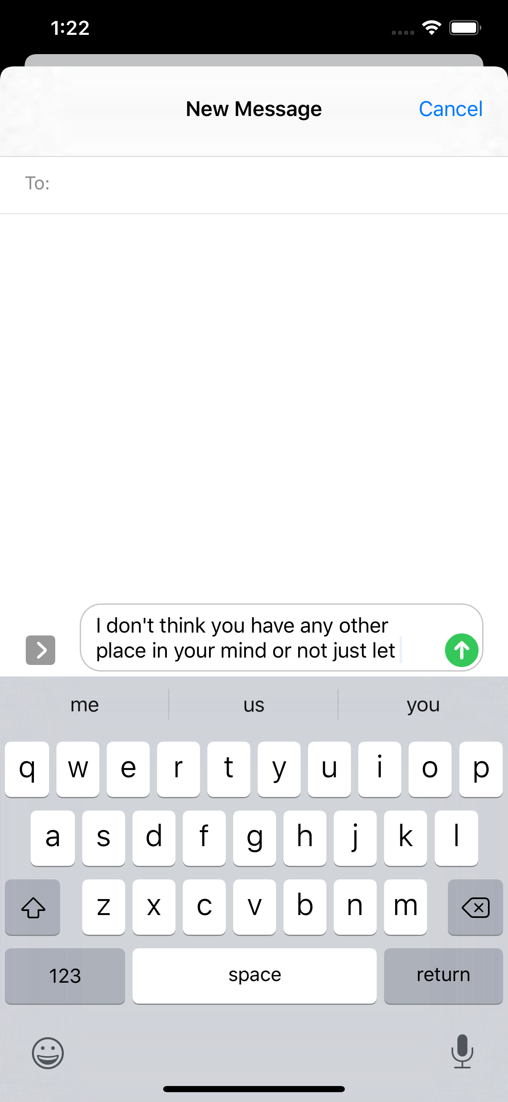
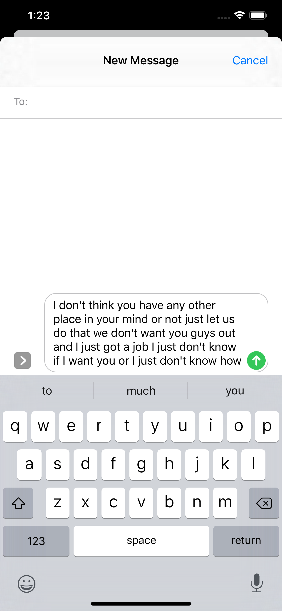
Notes:
New message
TAP

Slide 11
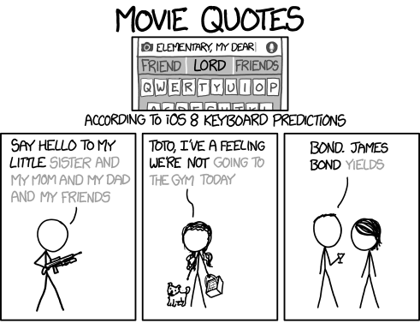
https://xkcd.com/1427/

Slide 12
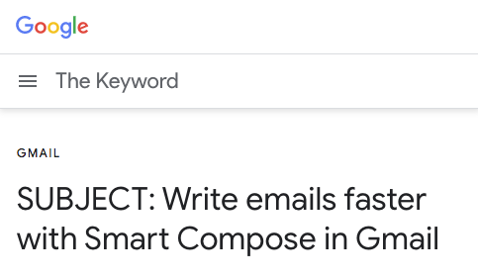
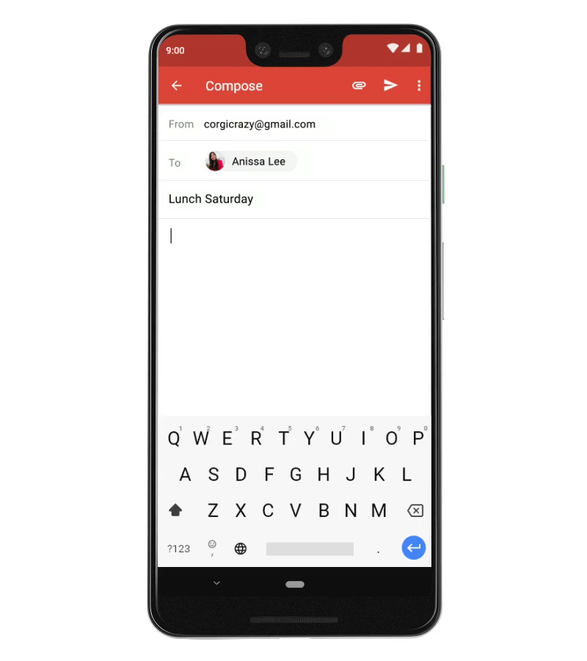
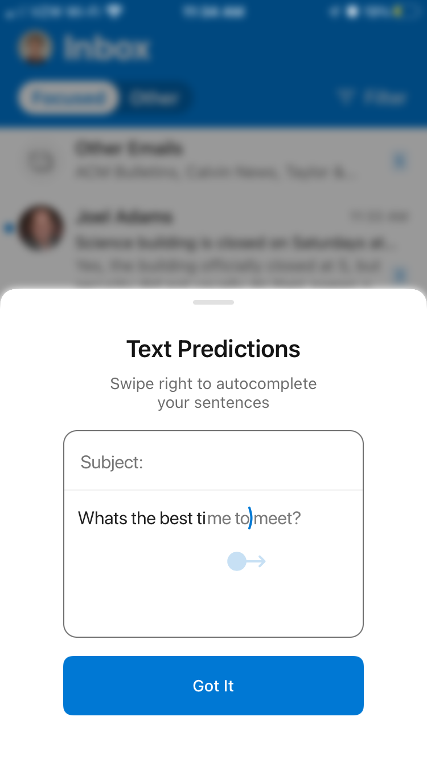
https://www.blog.google/products/gmail/subject-write-emails-faster-smart-compose-gmail/
Notes:
Now both phones and desktops have phrase predictions

Slide 13


Training Data
Language Model
Next-Word Probabilities
Suggestions
Writing in progress
Notes:
LM digests training text

Slide 14
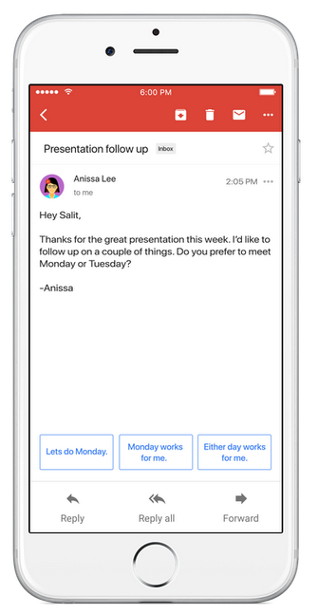
Predictive Text Suggestions

Slide 15
How do predictive suggestions shape content?
The text that people write using predictive text entry systems reflects biases of these systems.
“I have a phrase in mind and use suggestions that match.”
Bias noun. disproportionate weight in favor of or against an idea or thing
Notes:
For many, but not all

Slide 16
How might predictions shape us?
Writing choices are made in-the-moment
Suggestions are offered after each character typed — several per second
Prior studies couldn’t measure this
Transcription tasks: “Type this”
Speed and accuracy measures

Slide 17
Word Suggestions Discourage the Unexpected

Slide 18
Predictive Text Suggests what’s Most Expected
take
go
attend
visit
be
do
make
spend
travel
play
write
start
meet
have
return
bring
get
head
run
give
celebrate
show
continue
join
see
host
try
share
hold
walk
run
swim
ride
long
few
stroll
little
hike
quick
drive
drink
break
spin
shot
beer
bit
jog
second
big
good
bike
day
couple
while
nap
short
race
trip
excited
happy
much
good
young
scared
smart
small
different
proud
busy
cute
lucky
used
tired
close
very
beautiful
special
upset
grateful
old
far
nice
big
sick
amazing
cool
spoiled
This weekend I plan to
I want to go for a
My kids are so
Bias against these words
Notes:
Top-30 generation from GPT2

Slide 19
Suggestions favor certain kinds of words at the expense of others: a bias by design against the unexpected
Does writing with suggestions result in more of those kinds of words?

Slide 20
Study 1: Does writing conform to suggested words?
Vary suggestion visibility
Suggestions never visible
Suggestions always visible
Suggestions visible when system is confident
Tuned so that full-word suggestions are shown for ~50% of words
Hypothesis: Longer, more predictable words when suggestions visible

Slide 21
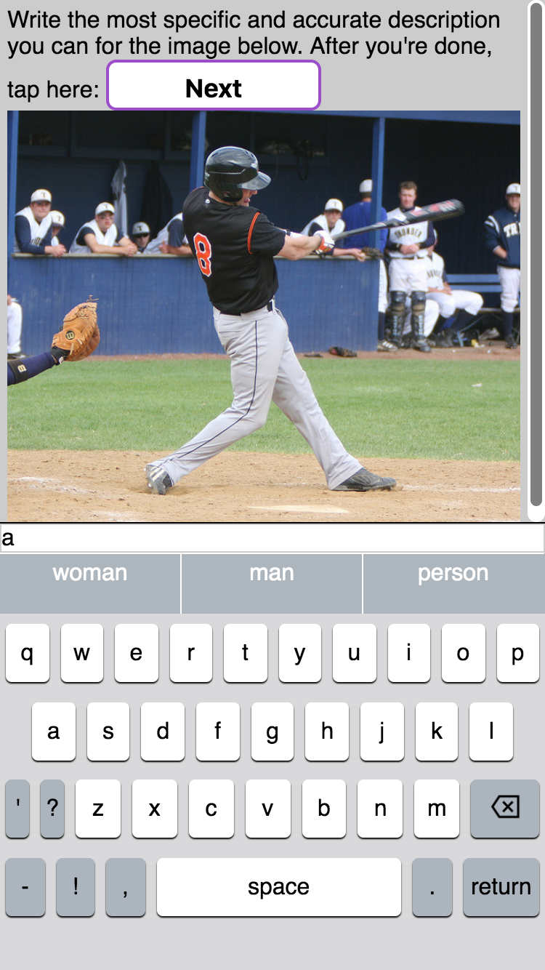
Image Captioning Task
Open-ended: suggestions can affect content (or not)
Repeatable: one participant can write many times

Slide 22
Suggestion Generation System
Recurrent neural network language model (LSTM)
Trained on image caption text (Common Objects in Context dataset)
“Blind”: doesn’t get to see actual image

Slide 23
Study Design
12 images, fixed order
Counterbalanced suggestion visibility
Participant 1
Suggestions Hidden
Suggestions Always Shown
Only Confident Suggestions
Participant 2
Suggestions Hidden
Only Confident Suggestions
Suggestions Always Shown
Participant 3
Suggestions Always Shown
Suggestions Hidden
Only Confident Suggestions
Participant 4
Suggestions Always Shown
Only Confident Suggestions
Suggestions Hidden
…
…
…
…

Slide 24
Results: Shorter Captions

Slide 25
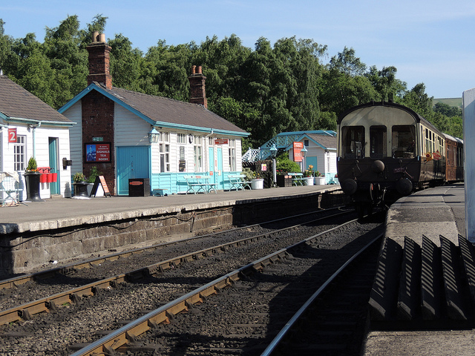
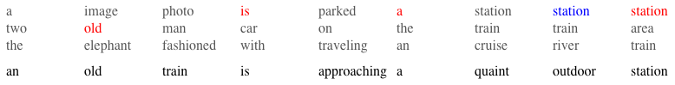
Predictability Measure
Notes:
Don’t mention blue words here

Slide 26
Results: Fewer Unexpected Words

Slide 27
Notes:
Bigger? Show all data?

Slide 28
Conjecture: two nudges
Counterfactual word: what would have been written without suggestions.
So we analyze the 436 captions written with suggestions hidden
Substitution: replace an unpredictable word with a predictable
Skip: remove a word (predictable or unpredictable)
Notes:
Also “add”, but that seems to be rare.

Slide 29
Substitution Nudge
Writer takes a suggested word instead of the counterfactual word
Outcome: more predictable, fewer unpredictable
Notes:
If counterfactual word was predictable, no substitution effect
If counterfactual word was unpredictable, predictive nudge…
# unpredictable words ↓
# predictable words ↑

Slide 30
Skip-Nudge
Suggests the word that would have been written after the next word
➔ nudge to skip a word
Occurred at least once in 69% of captions
Words most often skip-nudged: red, white, a, is, wedding, tennis, to, tree, sitting, small
Notes:
41% of skip-nudged words were predictable, so…
# of unpredictable words ↓
# of predictable words ↓

Slide 31
Overall: Shorter Captions, Fewer Unexpected
Notes:
For only-confident-visible suggestions: predictable words suggested less often –> reduced number of predictable words.

Slide 32


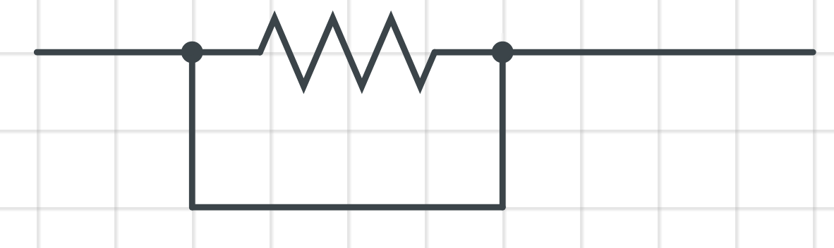
Suggestions may discourage thoughtfulness
Thinking about what to write
Accepting a suggestion
moderate by Erik Arndt from the Noun Project, easy by Tomi Triyana from the Noun Project

Slide 33
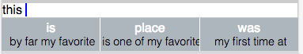
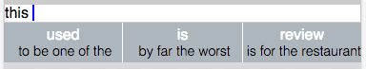
Study 2: Do positively-biased suggestions bias writing?
N=38 participants, each named 4 restaurants (both good and bad experiences)
Wrote reviews; system suggested sentiment-manipulated phrases
Positive slant
Negative slant
Measure: For each sentence in each review, 3 annotators (MTurk) rate positive content, negative content

Slide 34
Results: Positive-Slanted Suggestions ➔ Positive-Slanted Reviews
Effect size: about 1/3 star rating
No measurable effect on negative content
Subjective preference towards positive slant system
Negative slant viewed as less relevant
Excluding 3 participants who wrote without tapping keys at all
Notes:
Note: this was before I learned reproducible workflows, so I can’t easily replicate and improve that plot!

Slide 35
Predictive text biases writers.
Using predictive text leads to fewer unpredictable words IUI 2020
Phrases have stronger impact than words UIST 2016
Biases extend to meaning, not just low-level details GI 2018
Influence may be subconscious.

Slide 36
This is all by design.

Slide 37
What does the system do?
curWord
take
go
attend
visit
be
do
make
spend
travel
play
write
start
meet
have
return
bring
get
head
run
give
celebrate
show
continue
join
see
host
try
share
hold
This weekend I plan to
1. Compute probability of next word: P(curWord | context)
2. Suggest most likely word: argmax_{curWord} P(curWord | context)
context

Slide 38
Predict-the-next-word as classification
Technical name: causal language modeling
Don’t get to look at “future” words or backtrack
Task: given what came so far, predict the next thing
Next character: # possibilities (classes) = ______
Next word: # possibilities = _____
What else could we use as “next thing”?

Slide 39
What those computations look like
P(word | context) = softmax(wordLogits(word, context))
wordLogits(word, context) = dot(vec_{word}, vec_{contxt})
vec_{word}: look up in a (learnable) table: embedding
vec_{context} : computed by a neural network
Do you recognize this structure?

Slide 40
This week: Natural Language Processing
What tasks might we want to do with natural language?
How do we turn words into numbers and back?
How might we use neural nets for these tasks?

Slide 41
One architecture for everything?
Transformers (Vaswani+ 2007) have transformed language processing
… and most other machine learning also
Radical convergence: a single model architecture for all kinds of data and tasks. Just make everything look like a sequence
Language: sequence of words
Vision: sequence of image patches
Speech: sequence of audio segments
Behavior: sequence of actions and consequences
…!

Slide 42

So we’ll switch materials
Fastai: strong on vision, but weak on Transformers
So: switching to Hugging Face Transformers
Also built on PyTorch
Also built by some of the same people
Much better documented (phew!)
Course is starting to look good!
https://huggingface.co/course

Slide 43
Your job: do the HuggingFace course.
We’ll work through exercises together
We’ll fill in conceptual gaps together

Slide 44
Deep Neural Networks
Composition of 3 kinds of functions:
Similarity (dot product) with learnable prototypes (matrices)
Choice (softmax)
Bend (rectifier or other nonlinearity)
Training by gradient descent
How to adjust each prototype to boost the score of the right answer?
Each word can help tune every prototype that was involved
All functions are differentiable -> use chain rule to differentiate

Slide 45
Transformer Architecture
Attention mechanism: programmable information flow
Same softmax mechanism determines which other word to pay attention to
Also learned by gradient descent: boost the score of the word that would give the most helpful information

Slide 46
Self-Attention networks are powering an AI explosion
AlphaFold: predicting folded structure of proteins
Translation, summarization
CLIP / DALL-E: image generation
ViT – using these architectures for image recognition

Slide 47
Machine Learning is Multidisciplinary
Math: gradient descent, chain rule, matrix multiplication, …
Stats: conditional probability distributions, variance reduction, …
CS: functional programming, differentiation algorithm, parallel computing
People: human-computer interaction, psychology, …

Slide 48
It’s By Design
Models trained to mimic writers (huge computational effort!)
Interaction designed to suggest most likely next word (least surprising, least informative)
… like someone who’s eerily good at finishing your sentence.

Slide 49
What might writers want from a system?
Inspiration e.g., “How Novelists Use Generative LMs”
Efficient text entry e.g., predictive text, Smart Compose
…
Ownership and Autonomy
These are my words, not the computer’s.
The computer is giving me ideas, but not telling me what to write.
Do we want to be writers or editors? (maybe depends on task/genre?)
Notes:
Contrast with Refik, who foregrounds the machine in the output. And Loom / multiverse, where the human is mostly curator.

Slide 50
Creation: Genesis 1
In the beginning God created the heavens and the earth. Now the earth was formless and empty, darkness was over the surface of the deep, and the Spirit of God was hovering over the waters.
And God said, “Let there be light,” and there was light. God saw that the light was good, and he separated the light from the darkness. God called the light “day,” and the darkness he called “night.” And there was evening, and there was morning—the first day.
And God said, “Let there be a vault between the waters to separate water from water.” So God made the vault and separated the water under the vault from the water above it. And it was so. God called the vault “sky.” And there was evening, and there was morning—the second day.
And God said, “Let the water under the sky be gathered to one place, and let dry ground appear.” And it was so. God called the dry ground “land,” and the gathered waters he called “seas.” And God saw that it was good.
Then God said, “Let the land produce vegetation: seed-bearing plants and trees on the land that bear fruit with seed in it, according to their various kinds.” And it was so. The land produced vegetation: plants bearing seed according to their kinds and trees bearing fruit with seed in it according to their kinds. And God saw that it was good. And there was evening, and there was morning—the third day.
And God said, “Let there be lights in the vault of the sky to separate the day from the night, and let them serve as signs to mark sacred times, and days and years, and let them be lights in the vault of the sky to give light on the earth.” And it was so. God made two great lights—the greater light to govern the day and the lesser light to govern the night. He also made the stars. God set them in the vault of the sky to give light on the earth, to govern the day and the night, and to separate light from darkness. And God saw that it was good. And there was evening, and there was morning—the fourth day.
And God said, “Let the water teem with living creatures, and let birds fly above the earth across the vault of the sky.” So God created the great creatures of the sea and every living thing with which the water teems and that moves about in it, according to their kinds, and every winged bird according to its kind. And God saw that it was good. God blessed them and said, “Be fruitful and increase in number and fill the water in the seas, and let the birds increase on the earth.” And there was evening, and there was morning—the fifth day.
And God said, “Let the land produce living creatures according to their kinds: the livestock, the creatures that move along the ground, and the wild animals, each according to its kind.” And it was so. God made the wild animals according to their kinds, the livestock according to their kinds, and all the creatures that move along the ground according to their kinds. And God saw that it was good.
Then God said, “Let us make mankind in our image, in our likeness, so that they may rule over the fish in the sea and the birds in the sky, over the livestock and all the wild animals, and over all the creatures that move along the ground.”
So God created mankind in his own image, in the image of God he created them; male and female he created them.
(NIV)

Slide 51
Sin and Predictive Text
Automated lazy communication (“Thank you so much!”)
Self-centeredness (what’s easy for me to say?) vs thinking of reader
Dehumanization
Success = lots of suggestions accepted?

Slide 52
Jesus
Speaks grace and truth
Will judge our selfishness… and our dehumanizing technology
Gives the Spirit: wisdom, humility
Will redeem us (and has already started)
…and will redeem our technology
…and has already started.

Slide 53
“Let Your Kingdom Come”
Dreams of the renewed Creation
“Glory of the nations” (Revelation 21) includes our technology
(Re)shaping technology now

Slide 54
Goal: writer stays in control, system helps
Drafting stage
Conventional approach: generate “inspirational” examples
Our approach: ask questions
Editing stage
Conventional approach: identify and fix errors
Our approach: enable high-level editing

Slide 55
“Swords into plowshares” (Isaiah 2:3-5)
Repurpose existing technology for better use
Leverage pretrained language models
initially trained for mimicry
repurposed for empowerment
Two student projects
Sentence reorganization (April Volzer, Noah Madrid, Joseph Jinn)
AI Interviewer (Hyechan Jun, Ha-Ram Koo, and Advait Scaria)

Slide 56
Can Questions help writers with Drafting?
Suppose you’re writing a Wikipedia article about a sci-fi drama.
inspirational Example:
vs abstracted Question:
Research question: do writers find questions as useful as examples?
Experiment: sentence-level informational writing
Study Design: 30 MTurk participants wrote 10 sentences for each of 3 different prompt presentations
Snippets (of Featured Articles)
Questions (corresponding to those snippets)
No prompts
"Blade Runner" initially underperformed in North American theaters and polarized critics; some praised its thematic
How did it initially perform? How did critics react? What aspects did critics praise? What aspects did critics condemn?
Notes:
Why: questions interfere less with writer’s ideas
Why not: inspirational examples are more specific, more analogous to writer’s goal

Slide 57
Writers strongly preferred Questions
While writing, more of the Questions were relevant.
After writing, writers subjectively favored Questions

Slide 58
Could writing feel more like conversation?
“Interesting, tell me more!”
“What were they doing before that happened?”
“Have you thought about this perspective?”
Question generation can be
more forgiving of error than next-word prediction
natural, like getting interviewed
Question-asking is a ripe opportunity for intelligent systems

Slide 59
Goal: writer stays in control, system helps
Drafting stage
Conventional approach: generate “inspirational” examples
Our approach: ask questions
Editing stage
Conventional approach: identify and fix errors
Our approach: enable high-level editing

Slide 60
Exploring alternative wordings is difficult
Cognitive: fixation on what’s already written
Mechanical: non-local edits
tedious: cut/paste, retype, cursor navigation within a sentence
error-prone: forgetting updates
Goal: easy to explore alternative wordings of a sentence
Co-creative interaction: once writer selects a sentence…
system recommends alternative wordings
writer refines by semantic editing operations

Slide 61
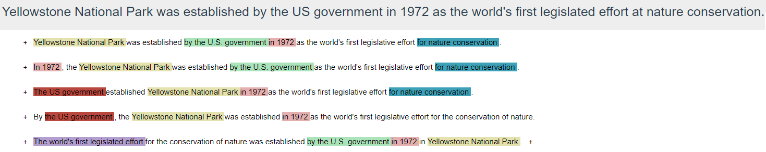
System recommends high-quality diverse paraphrases
Notes:
[Yellowstone…conservation…., Legislative]
[Yellowstone conservation, U.S.],
[Legislative, 1972]]

Slide 62

Writer refines by semantic edits
e.g., drag and drop phrases
It was earlier demonstrated by researchers that heart attacks can be caused by high stress.
select
It was earlier demonstrated by researchers that heart attacks can be caused by high stress.
drag
earlier demonstrated researchers high stress heart attacks caused
drop
It was earlier demonstrated by researchers that high stress can cause heart attacks.

Slide 63
Approach: Paraphrase by round-trip translation
To recommend reorderings, we vary sentence openings
Identify candidate sentence-openers using heuristics on dependency tree
Beam-search for completions of each candidate opener
Filter bad paraphrases (e.g., content words dropped)
Re-rank by sentence likelihood
Interpret reordering edits as partial ordering on words
use constrained beam search (Hu et al. 2019) (work in progress)
Other editing operations: specifying what aspect to emphasize, replacing phrases with synonyms, etc. (work in progress)

Slide 64
AI Interviewer
A skilled interviewer brings out the best in their guests
Could an AI likewise inspire writers?
CS Senior Project (Hyechan Jun, Ha-Ram Koo, and Advait Scaria)
Dataset: NPR interview transcripts
Task: Mimic NPR interviewers
Approach: “fine-tune” language models to generate host’s utterance given previous guest utterance
Two base models: GPT-3 (OpenAI / Microsoft), BART (Facebook)

Slide 65
Guest
It's not at all unexpected. If anything, investors and some people in the auto industry had been begging Ford to make this step. General Motors Corp. earlier this year did something quite similar. […]
AI Response
Well, why did Ford take this step now?
NPR Interviewer
The UAW traditionally has been one of the biggest, most powerful labor unions in America. Is the union, because of Ford's woes, being forced to take whatever the company offers?
Legend: Concept overlap

Slide 66
Sometimes it works great…
Welcome to the BART Interactive Interview AI!
Tell us an interesting story, or type 'END' to stop.
> I have a cat. His name is Jonathan. He is seven years old and has black fur.
AI: And how did you decide to adopt Jonathan?

Slide 67
And sometimes it, well…
Welcome to the GPT-3 Interactive Interview AI!
Tell us an interesting story, or type 'END' to stop.
> Hello. My name is Hyechan. I'm a senior at Calvin University studying computer science.
AI: And how do you translate these skills in things like software testing, which you've mentioned, to the business world? Do you see your career path in either one?

